Slide 1
Graph

Slide 2
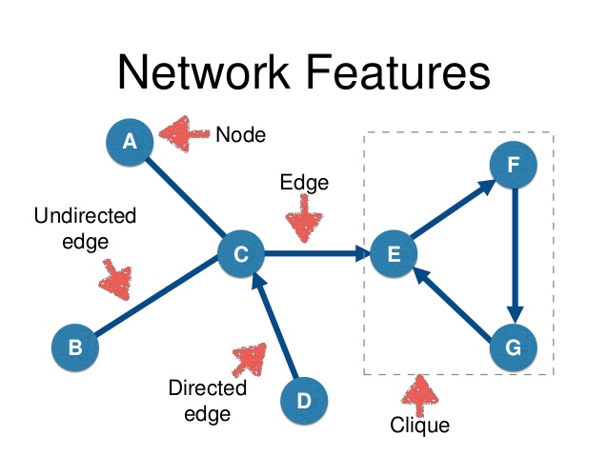
Sudah pernah belajar graph?

Slide 3

Mungkin sudah sering pakai

Slide 4
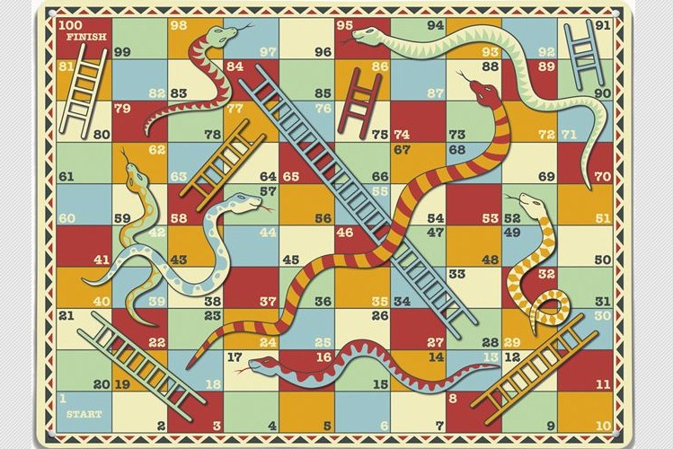
Mungkin sudah sering pakai
100
99
98
97
81
82
83
84
80
79
78
77

Slide 5
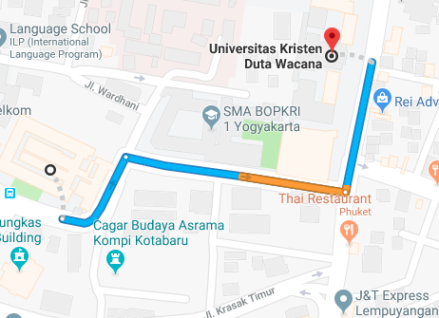
Mungkin sudah sering pakai

Slide 6
Cara merepresentasikan Graph dalam Code

Slide 7
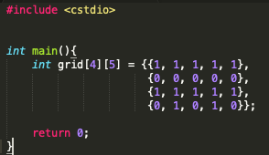
Array 2D
1 | 1 | 1 | 1 | 1
0 | 0 | 0 | 0 | 0
1 | 1 | 1 | 1 | 1
0 | 1 | 0 | 1 | 0

Slide 8
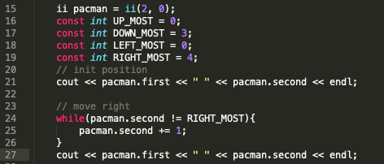
Array 2D
2 0
2 4

Slide 9
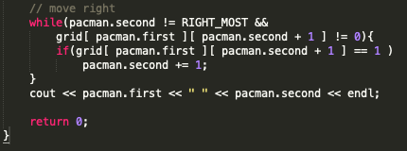
Array 2D
2 0
2 4

Slide 10
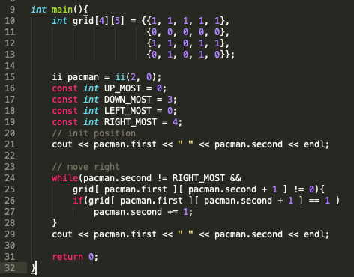
Array 2D
2 0
2 1

Slide 11
2. Adjacency Matrix : space -> O(V²)
 | 0 | 1 | 2 | 3 | 4 | 5 | 6
0 | 0 | 1 | 0 | 0 | 0 | 0 | 0
1 | 1 | 0 | 1 | 1 | 0 | 0 | 0
2 | 0 | 1 | 0 | 0 | 0 | 0 | 0
3 | 0 | 1 | 0 | 0 | 1 | 0 | 0
4 | 0 | 0 | 0 | 1 | 0 | 1 | 1
5 | 0 | 0 | 0 | 0 | 1 | 0 | 0
6 | 0 | 0 | 0 | 0 | 1 | 0 | 0
0
1
3
4
6
2
5

Slide 12
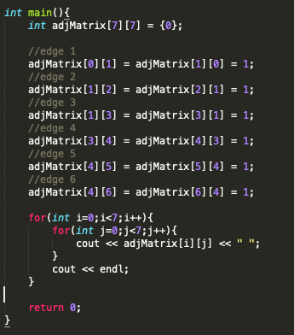

2. Adjacency Matrix : space -> O(V²)

Slide 13
3. Adjacency List : space -> O(V + E)
 | List
0 | 1
1 | 0 2 3
2 | 1
3 | 1 4
4 | 3 5 6
5 | 4
6 | 4
0
1
3
4
6
2
5

Slide 14
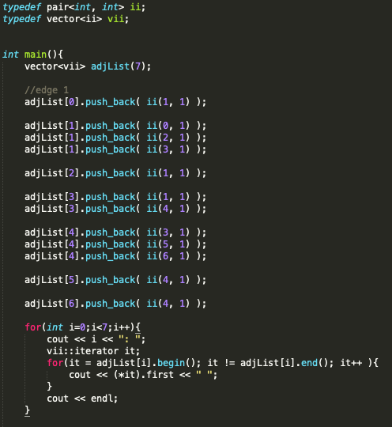

3. Adjacency List : space -> O(V + E)

Slide 15
3. Edge List : space -> O(E)
 | List
0 | 0 1
1 | 1 0
2 | 1 2
3 | 2 1
4 | 1 3
5 | 3 1
6 | 3 4
 | List
7 | 4 3
8 | 4 5
9 | 5 4
10 | 4 6
11 | 6 4
0
1
3
4
6
2
5

Slide 16
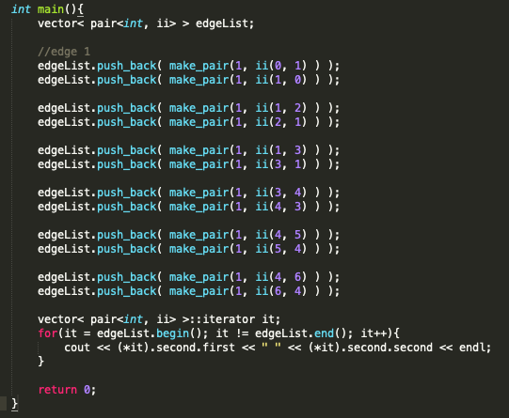

3. Edge List : space -> O(E)

Slide 17
Cara searching /
graph traversing

Slide 18
DFS
Depth First Search
BFS
Breadth First Search

Slide 19
Depth First Search
1
4
0
1
3
4
6
0
1
3
4
6
2
5
2
5
2
5
0
1
3
4
6
0
1
3
4
6
2
5
2
5
3
6
0
1
3
4
6
0
1
3
4
6
2
5
2
5

Slide 20
Breadth First Search
1
4
0
1
3
4
6
0
1
3
4
6
2
5
2
5
2
5
0
1
3
4
6
0
1
3
4
6
2
5
2
5
3
6
0
1
3
4
6
0
1
3
4
6
2
5
2
5

Slide 21

DEMO DFS & BFS
Simple pacman | Array 2D

Slide 22
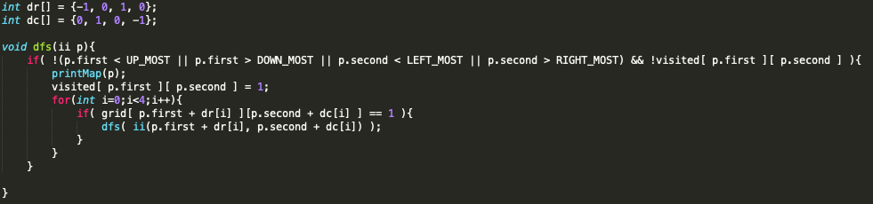
DEMO DFS & BFS
DFS Code

Slide 23
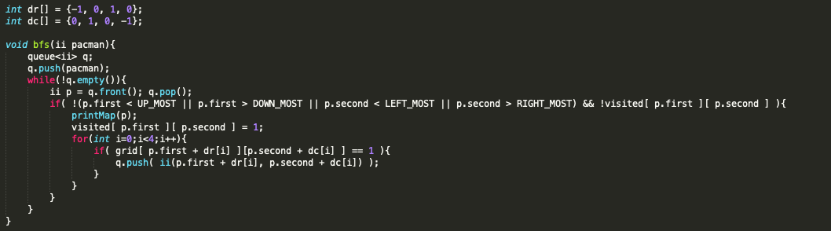
DEMO DFS & BFS
BFS Code

Slide 24
Practice
30
menit
UVA 10928 - My Dear Neighbours
UVA 469 - Wetlands of Florida

